Slide 1
INVESTMENT CASE STUDY SUBMISSION
Sunil Yousef

Slide 2
To understand the global trends in investments so that CEO of Spark Fund can take the investment decisions effectively
Spark Funds wants to find the best companies in top3 countries under top3 sectors to invest in within the constraints mentioned below:
The investment should be made only in English-speaking countries and should be between 5 to 15 million USD per round of investment
The investment should be made in the sector where most other investors are investing
The project is to identify:
Top3 countries among the countries that had the most investments in past and select them as preferred countries for Spark Funds.
Most suitable investment type by understanding investments in venture, seed/angel, private equity categories etc. and identify which type is best suited for Spark Funds strategy.
Most suitable sectors by understanding the distribution of investments across the 8 main sectors, and select the best sector for Spark Funds investment strategy.

Slide 3
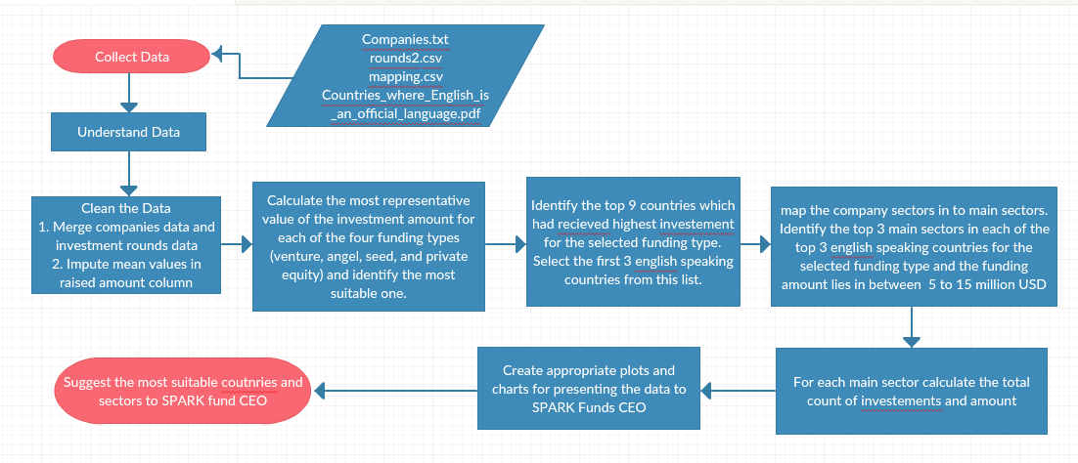
Problem solving methodology

Slide 4
Understand the Data Set’s
 | How many unique companies are present in rounds2? | 66368
 | How many unique companies are present in the companies file? | 66368
 | In the companies data frame, which column can be used as the unique key for each company? Write the name of the column. | PERMALINK
 | Are there any companies in the rounds2 file which are not present in companies ? Answer Y/N. | N
 | Merge the two data frames so that all variables (columns) in the companies frame are added to the rounds2 data frame. Name the merged frame master_frame. How many observations are present in master_frame ? | 114949

Slide 5
Most suitable investment type is Venture Fund
Average funding amount of venture type | 11623493
Average funding amount of angel type | 2875945
Average funding amount of seed type | 2920791
Average funding amount of private equity type | 63704338
Considering that Spark Funds wants to invest between 5 to 15 million USD per investment round, which investment type is the most suitable for them? | VENTURE
Venture Fund is selected as it is the one which lies in the range of 5 to 15 Million USD

Slide 6
Top 3 English-Speaking Countries
Top English speaking country | USA
Second English speaking country | GBR
Third English speaking country | IND
Spark Funds wants to invest in countries with the highest amount of funding for the chosen investment type as part of its broader strategy to invest where most investments are occurring.
Spark Funds wants to see the top nine countries which have received the highest total funding (across ALL sectors for the chosen investment type)
Identify the top three English-speaking countries in the data frame top9.

Slide 7
Top 3 Sectors
Total number of Investments (count) | 40372 | 2265 | 984
Total amount of investment (USD) | 4.68E+11 | 2.24E+10 | 1.60E+10
Top Sector name (no. of investment-wise) | Others | Others | Others
Second Sector name (no. of investment-wise) | Cleantech / Semiconductors | Social, Finance, Analytics, Advertising | Social, Finance, Analytics, Advertising
Third Sector name (no. of investment-wise) | Social, Finance, Analytics, Advertising | Cleantech / Semiconductors | News, Search and Messaging
Number of investments in top sector (3) | 9847 | 615 | 355
Number of investments in second sector (4) | 8416 | 460 | 172
Number of investments in third sector (5) | 8010 | 456 | 154
For point 3 (top sector count-wise), which company received the highest investment? | SoFi | OneWeb | Flipkart
For point 4 (second best sector count-wise), which company received the highest investment? | Freescale Semiconductor | Mereo | ShopClues.com
The most heavily invested sector is “Others”.
And the second preferred sector is “Social, Finance, Analytics, Advertising”

Slide 8
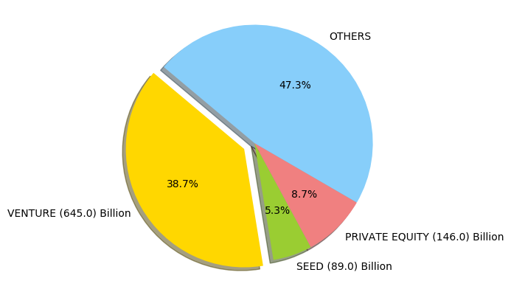
Most suitable investment method is Venture as per the pie chart shown below.

Slide 9
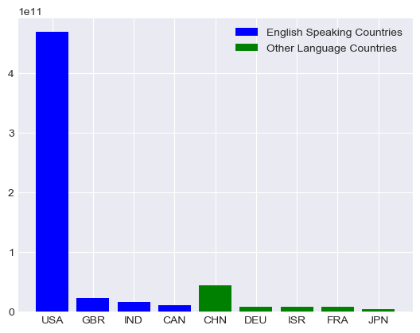
Countries which got most of the investments for venture type fund

Slide 10
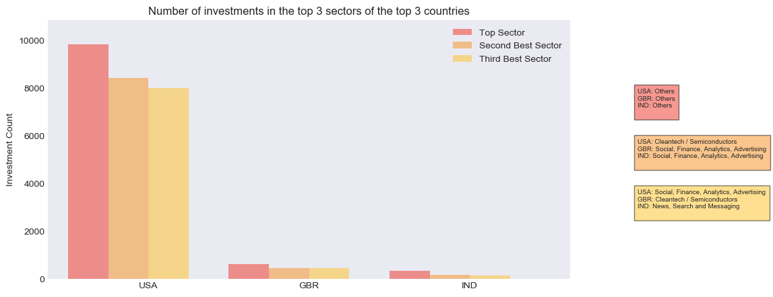
Top3 sectors based on number of investments from the top 3 countries

Slide 11
Conclusions - Recommended countries and there main sectors are,
Top 3 English Speaking countries for the Venture type funding is: United States of America, Great Britain and India
Most suitable sectors in United States of America, Great Britain and India is: "Others" and "Social, Finance, Analytics, Advertising”
Sector "Cleantech / Semiconductors" is recommended only for Great Britain and United States of America
Sector “News, Search and Messaging" is recommended only for India.

